Slide 1

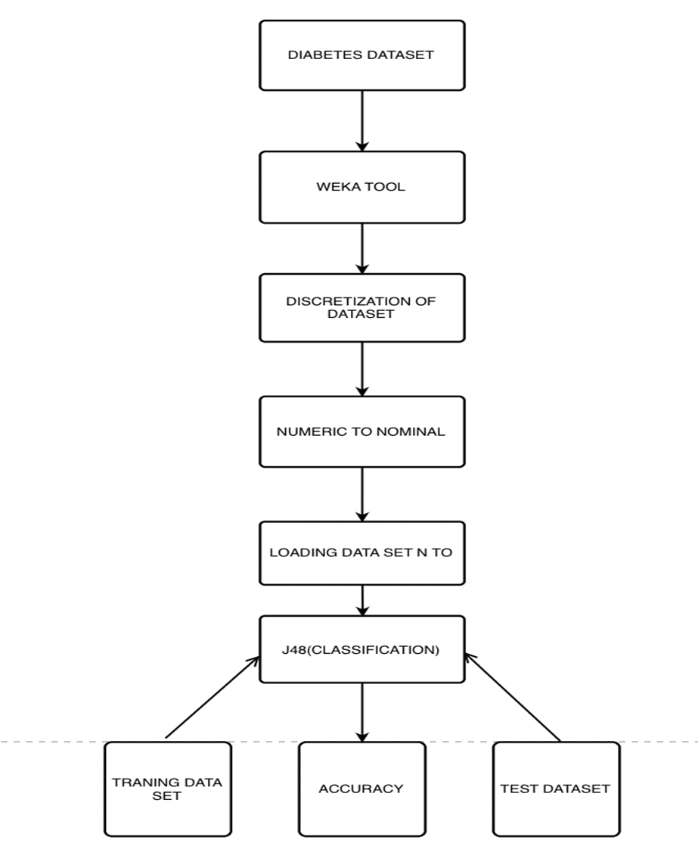
DIABETES PREDICTION
Keerthana Mallavarapu
Abstract
This project aims to predict whether a patient has diabetes or not, or whether the patient is pre-diabetic based on diagnostic measurements. The type of model/data mining task that will be used for the prediction is classification. This project aims to predict whether a patient has diabetes or not, or whether the patient is pre-diabetic based on diagnostic measurements. The type of model/data mining task
that will be used for is prediction.
System Architecture
TEST RESULTS
Conclusion
Diabetes is one of the most prevalent chronic diseases impacting millions of people each year physically, mentally, and financially. The disease poses the danger where individuals lose the ability to regulate glucose levels in the blood, leading to complications like heart disease, vision loss, lower-limb amputation, and kidney diseases. Although there is no known cure for diabetes, many individuals can lessen its negative effects by adopting lifestyle changes such as decreasing weight, eating a healthy diet, exercising, and receiving medical care.
Methodology
This project aims to predict whether a patient has diabetes or not, or whether the patient is pre-diabetic based on diagnostic measurements. The type of model/data mining task that will be used for the prediction is classification. The data contains 3 class, diabetic, non-diabetic and pre-diabetic. The dataset contains attributes like blood pressure, cholesterol, BMI, whether the person smokes or not, whether the person had a history of cardiac arrest, physical activity, eating style, sex, age etc. The data is cleaned by removing the attributes like education and financial status which are not useful for prediction of diabetes.
Visualization of Data
Motivation
Diabetes cases are increasing drastically, because of current human life style. There are three possible errors in the Current Diagnosis method. The false negative -the patient is already diabetic but result shows non diabetic, the false positive -patient is non diabetic but report says he is Diabetic, Unclassifiable-system cannot diagnose. This happens due to insufficiency in historical data extraction. This may lead to improper diagnosis. To reduce severity of such impacts, there is a need to create a system using machine learning algorithm and datamining techniques, which will provide accurate results and reduce human efforts
References
[1] Gauri D. Kalyankar, Shivananda R. Poojara and Nagaraj V. Dharwadkar,” Predictive Analysis of Diabetic Patient Data Using Machine Learning and Hadoop”, International Conference On I-SMAC,978-1-5090-3243-3,2017
[2] Ayush Anand and Divya Shakti,” Prediction of Diabetes Based on Personal Lifestyle Indicators”, 1st International Conference on Next Generation Computing Technologies, 978-1-4673-6809-4, September 2015
The dataset is obtained from Kaggle. It consists of 22 attributes and over 2 lakh rows which we will be using for training and testing. Attributes like education and income are removed as they are not relevant to diabetes and its prediction. We have divided the data into 2 categories, training and testing and compressed the data size.
Fig. 5 Apriori Algorithm

